Slide 1
Agenda
9:30 am – 10:00 am: Coffee & Registration
10:00 am: Welcome & Initiative Overview
10:20 am: Ambassadors on the Why, What, Where, & How of OER
11:30 am: Open & Affordable Textbooks Program at Rutgers University
11:45 am: Interactive Activity
12:00 pm – 01:00 pm: Lunch
01:00 pm – 2:00 pm: Panel Discussion / Q&A

Slide 2
Regional OER Workshop
County College of Morris, Friday, October 25th
Presented by VALE NJ and your 2019-2020 OER Ambassadors
This work is licensed under a Creative Commons Attribution 4.0 International License.Some slides adapted from “Open Textbooks: Access, Affordability, and Academic Success” by Open Textbook Network under the Creative Commons Attribution 4.0 International License.

Slide 3
2019-2020 OER Ambassadors
Alison Cole, Felician University
Ken Karol, Passaic County Community College
Janet Marler, Ocean County College
Marilyn N. Ochoa, Middlesex County College
The ambassadors can be contacted at njoerambassadors@gmail.com

Slide 4
Why, What, Where, & How of OER
Why? Define the problem.
What? Define open textbooks.
Where? Where to find Open Educational Resources.
How? Explain what actions we can take.

Slide 5
Why OER?

Slide 6
“…higher education shall be equally accessible to all”

Slide 7
High quality education should be available to the top 100% of all students.
Dr. Martha Kanter
Notes:
Less lofty, but more humorous! Founder of the Community College Open Educational Resources, former Undersecretary of Education (under President Obama) and former Chanceller of the Foothill-DeAnza Community College District.

Slide 8
The U.S. Department of Education projected that the cost would keep
2.4 million
low and moderate-income college-qualified high school graduates from completing college in the previous decade.
The Advisory Committee on Student Financial Assistance http://files.eric.ed.gov/fulltext/ED529499.pdf

Slide 9
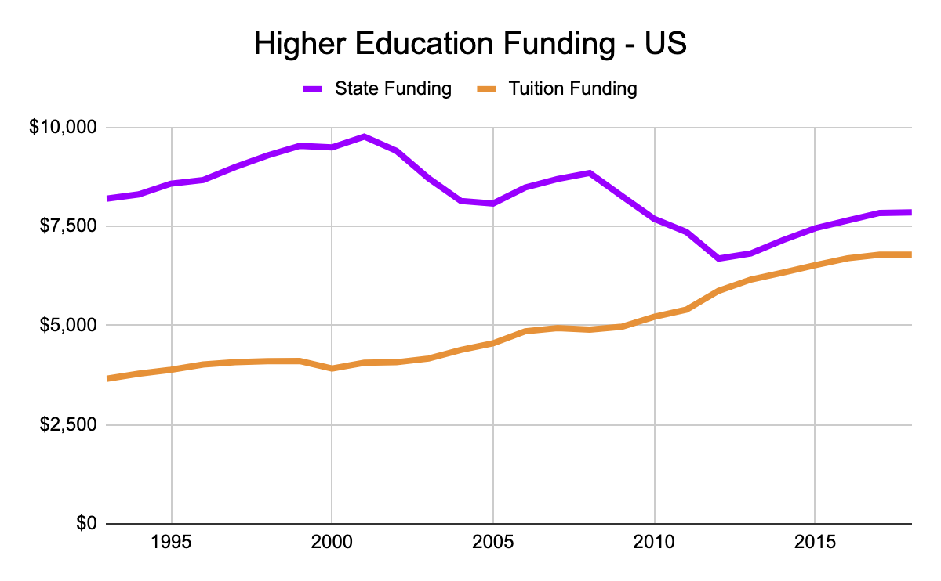
http://www.sheeo.org
Notes:
Shows how the burden of paying for higher education has shifted from the state to the student. Compare the proportion of cost that students must contribute in 1993 to today (The load on students has doubled).

Slide 10
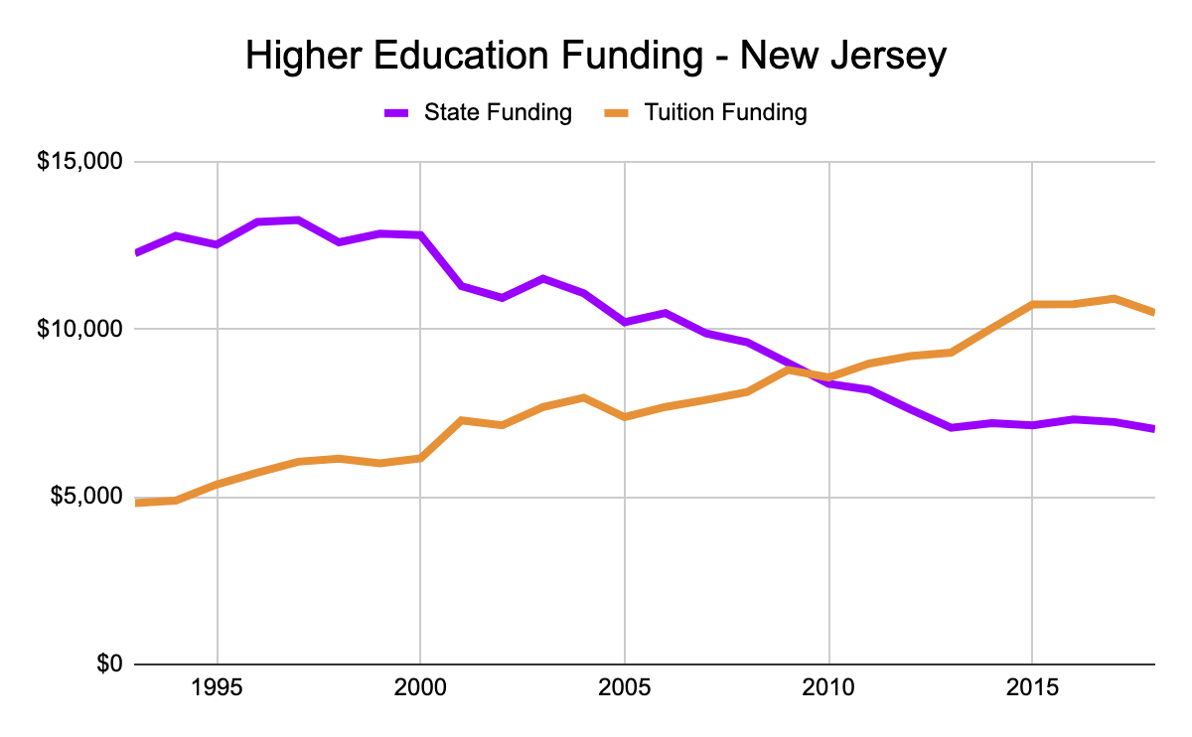
Notes:
In New Jersey, the contrast between state funding and tuition funding of education is even starker.

Slide 11
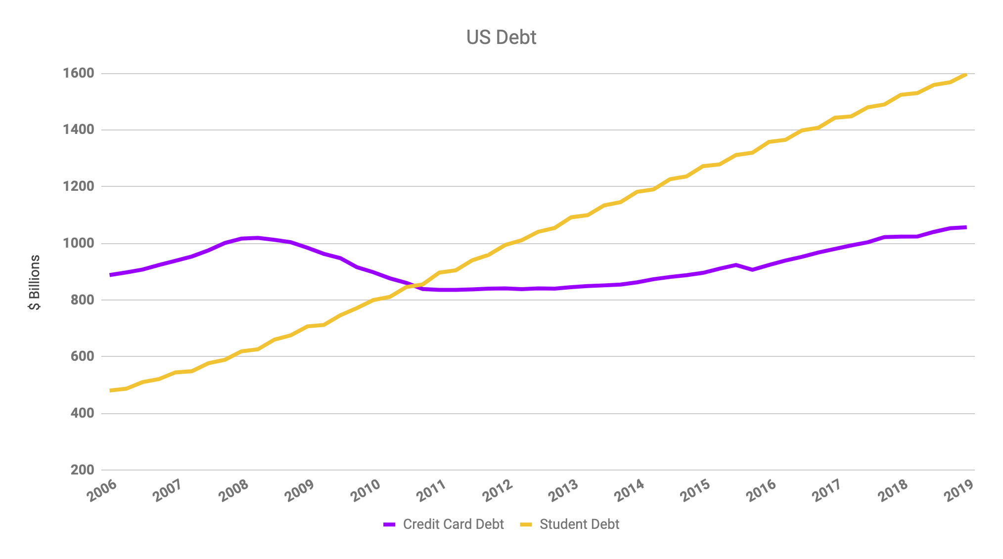
Federal Reserve http://www.federalreserve.gov/releases/g19/Current/
Notes:
Consumer Revolving Credit = Credit Card Debt
Tripled in just a decade, over 1.4 Trillion

Slide 12
Notes:
Students’ financial situation have on their everyday lives. Food pantries are now becoming ubiquitous as students struggle to afford to live while paying for college.

Slide 13
https://cufba.org/
Notes:
This is more evidence that cost is having a dramatic impact on students’ every day lives.
The College and University Foodbank Alliance is an organization of higher ed institutions that runs foodbanks. It started in 2012 with 13 members and as of September, 2019, they have 700+ members.
Students can’t afford textboks because something else (food insecurity, cost of daycare, supporting family members, etc.) is causing them to not be able to afford the book.

Slide 14
What can we do?
Tuition and Fees
Room and Board
Books and Supplies
Personal Expenses
Transportation
Notes:
These are the major expense categories for students. Which one do you think we’re going to talk about today?

Slide 15
What can we do?
Tuition and Fees
Room and Board
Books and Supplies
Personal Expenses
Transportation
Notes:
It’s important to stop and admit that “books and supplies” is not the highest cost leading to these affordability issues. Ask the attendees: “So, why are we talking about this one?”:
the one cost that we as faculty can impact
it has a disproportionate impact on the academic success of students (as we’ll see later)

Slide 16
Ease of access
Notes:
This reminds me of when I asked my composition students what they noticed first about my phone, and they unanimously said, “It’s old!” (It had a hot pink case.) A student panel at Raritan last spring repeatedly noted that they liked being able to access their course materials on their phones.

Slide 17
Things students like about OER:
While cost may be a primary driver of the push towards OER, students appreciate:
Ease of access
Instant access--students are able to access course materials without any waiting period. There is no financial or other barrier to instant access.
Flexibility: courses can be more interesting when there is a range of materials for faculty to choose from. The class isn’t as limited to the material in a specific textbook.
Interactive: professors may ask students to assist in customizing the course.

Slide 18
Faculty like:
All the students have access to the text and course materials from the first day.
Flexibility: there can be more opportunity to customize a class.
Academic freedom/quality: the wealth of materials and accompanying evaluations by other faculty enhance academic instructions.

Slide 19
Finally, last May, A-327-3254-1149 was signed into law:
Institutions of higher education are required to have a plan in place by May 2020 articulating the steps they are and will be taking to make both OER and commercially available no-cost and low-cost textbooks as available as possible to students.

Slide 20
What makes something OER?
Notes:
Ali - What exactly makes something OER & Where do I find Resources? 20 minutes

Slide 21
What exactly is OER?
OER [Open Educational Resources] are teaching, learning, and research resources that reside in the public domain or have been released under an intellectual property license that permits their free use or re-purposing by others.
Open educational resources include:
full courses, course materials, modules, textbooks, streaming videos, tests, software, and any other tools, materials, or techniques used to support access to knowledge.
Atkins, D.E., Brown, J.S. & Hammond, A.L. (February 2007). A review of the open educational resources (OER) movement: Achievements, challenges, and new opportunities. Report to The William and Flora Hewlett Foundation. p. 4
Notes:
In other words, OER are educational resources that have been released under less-restrictive licenses than traditionally published material.
OER can take many forms, such as:
textbooks
images
articles
PowerPoint decks
Full curricula
Anything else you might want to use in the classroom

Slide 22
creativecommons.org
Notes:
… the Creative Commons. CC is a nonprofit that created licenses to help people who want to share copyrightable intellectual property.

Slide 23
All Rights
Reserved
Some Rights
Reserved
Notes:
So, Creative Commons works alongside copyright for those who want to legally share their rights.

Slide 24
With Creative Commons licenses, you are free to…
Copy | Mix
Share | Keep
Edit | Use
Notes:
A Creative Commons license allow for these things…you may have heard these called the 5 R’s: Retain, Reuse, Revise, Remix and Redistribute. This is just a different way of saying that with a CC license, you can SHARE!

Slide 25
Defining the “Open” in Open Content and OER
Notes:
5 Rs

Slide 26
Notes:
So, when you see this symbol on a work, it means that the creator of the work intends the work to be freely used, shared, and ...

Slide 28
Notes:
These are the 6 CC licenses. Maybe even quiz them on one or two...
Note that these licenses are used in many places, but we often don’t notice them. For instance. . . .

Slide 29
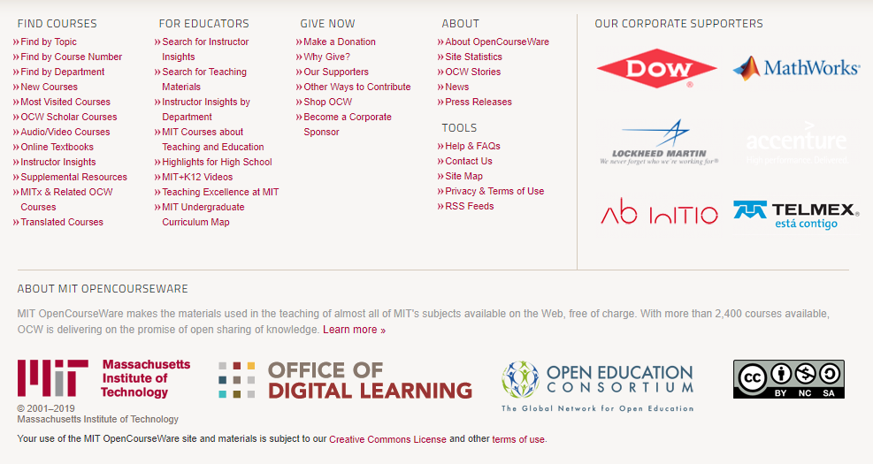
Notes:
Now that you know what these licenses are, you will notice that they are used all over the internet.
MIT Open Courseware
This is a screenshot from an OCW page – there was a video above. Note the license.
MIT wants you to use it, and here are their terms: (BY NC SA). Ask what that means.

Slide 30
Notes:
TED Talks: BY NC ND
Ask what that means.

Slide 31
Notes:
Now that you know what a CC license is, any copyrightable intellectual property item with a Creative Commons license on it is an open educational resource or OER. A textbook with a CC license is an open textbook--free plus permissions. Based on the CC license, we can do all of those things we talked about: Copy, Mix, Share, Keep, Edit, and Use.

Slide 32
Introductory, algebra-based, two-semester college physics
1272 pages
Available in
PDF
Print
Web
openstax.org
Notes:
Just because a book is open, don’t assume it doesn’t come with ancillary resources because some do. This is the #1 adopted Physics book in the nation. OpenStax tracks those stats. This is a two-semester book and you can get a print version for about 20% of what a commercial book would be. And third-party vendors like Bookshare provide an online service where you can get content converted to accessible formats--Braille, etc. Couldn’t technically do legally with a commercial textbook. So, an open textbook is a textbook with a CC license – it’s free and you are given the permissions we just discussed AND it may come with ancillary student resources and instructor resources.

Slide 33
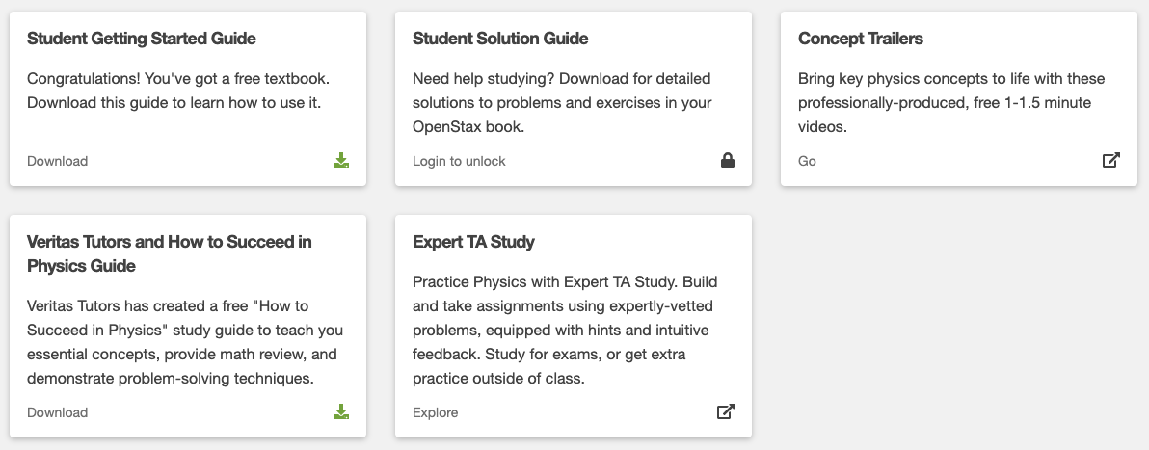
Student Resources
Notes:
Examples of student resources with the OpenStax Physics course.

Slide 34
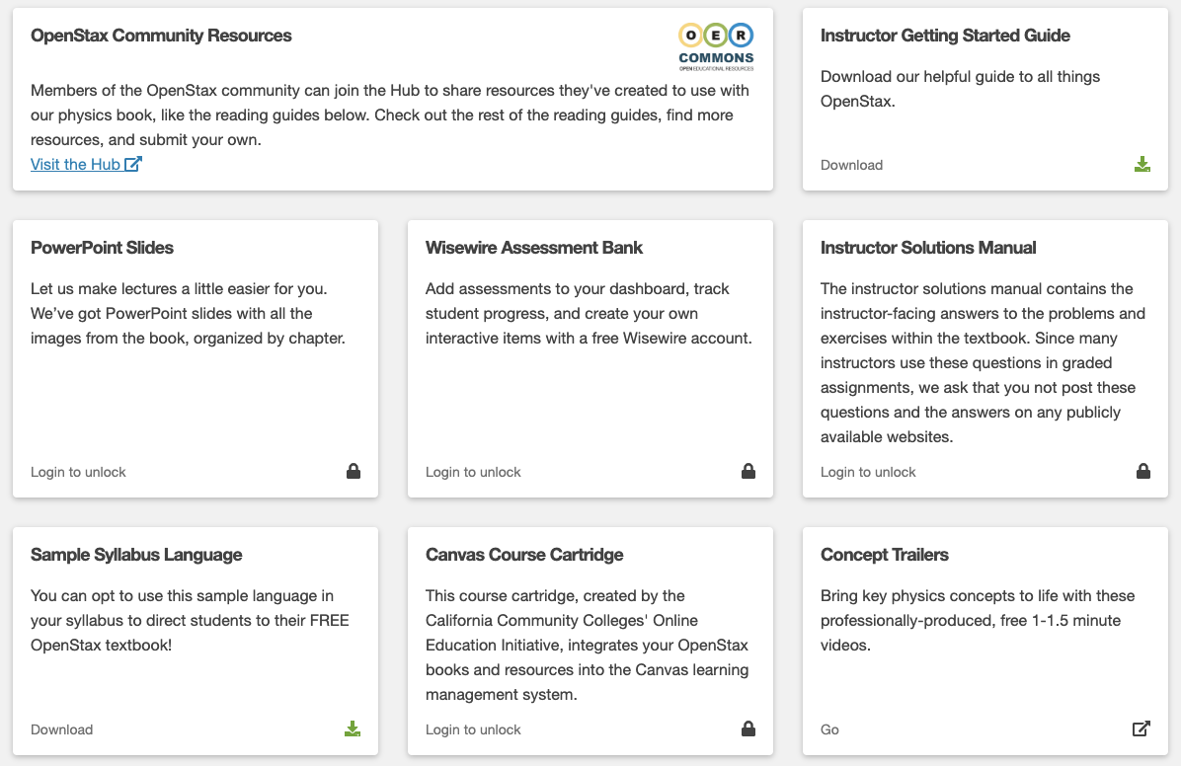
Instructor Resources
Notes:
The whole point of this is that we should not assume that open textbooks don’t come with ancillaries and resources.

Slide 35
Open Vs. Free
Open is always Free, but Free is not always Open.
There are many freely accessible resources you can utilize to lighten the cost burden of your students.
Free Access ≠ Open Access
“Knowledge is open if anyone is free to access, use, modify, and share it”
http://opendefinition.org/

Slide 36
Open & Affordable Options
Replace a traditional textbook with a free, low-cost, or open alternative
Replace a traditional textbook with articles, book excerpts, audio, or video that are
licensed through your university library
open access
freely available online
Replace a traditional, high-cost textbook with one that YOU design, author, and provide for free or at low cost to students

Slide 37
Where do I find OER?
Notes:
Marilyn

Slide 38
Where do I find OER?
OpenStax.org
Open Textbook Library
OER Commons
OPEN SUNY
Ask!
Notes:
OTN & OpenStax
Oer Commons
ListServs - ask around!

Slide 39
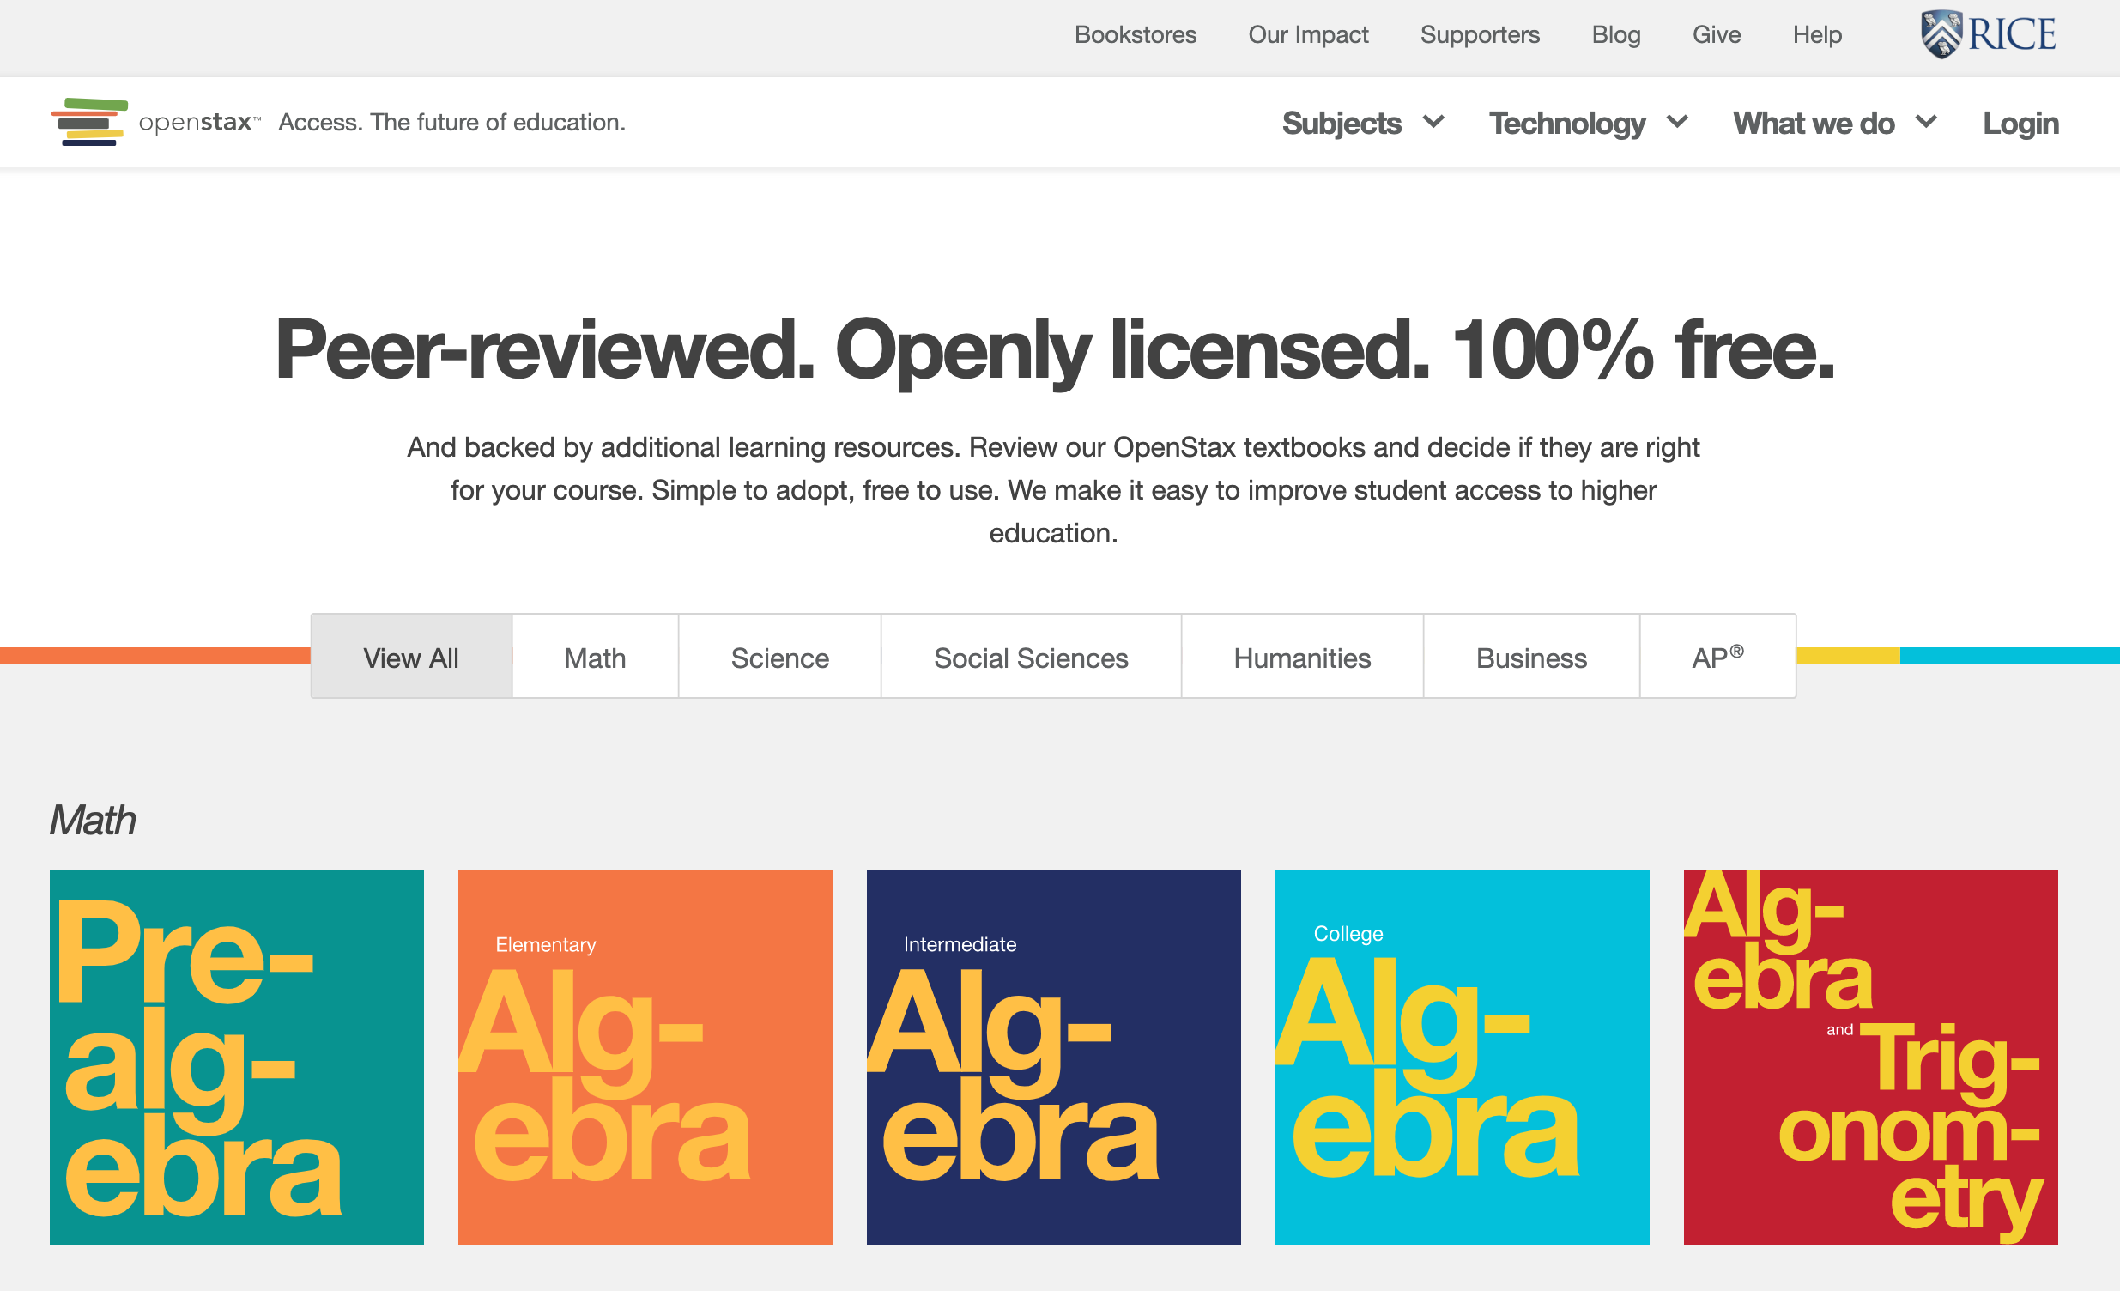
Notes:
OpenStax is the branding of the textbooks published by Rice University. They set out to publish textbooks for the top 25 enrolled courses in the US. They were initially funded by foundations, but they are now self-sustaining. Sarah will contact Nicole F. and find out market share for OpenStax.

Slide 40
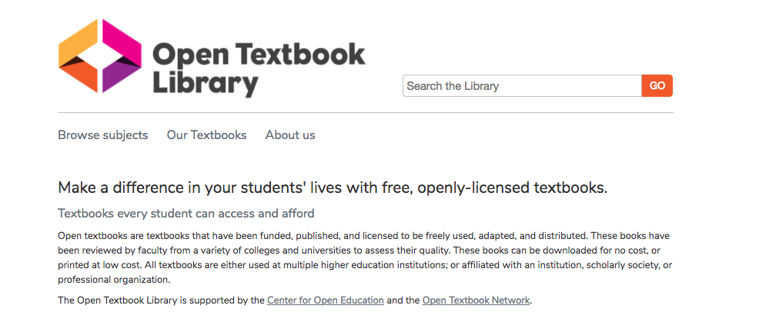
open.umn.edu
Notes:
One good place to look is the OTL. The OTL is the most comprehensive catalog of open textbooks. Also, the OTL includes faculty reviews for about ⅔ of the textbooks in the collection, and we are continuously adding books to the Open Textbook Library.

Slide 41
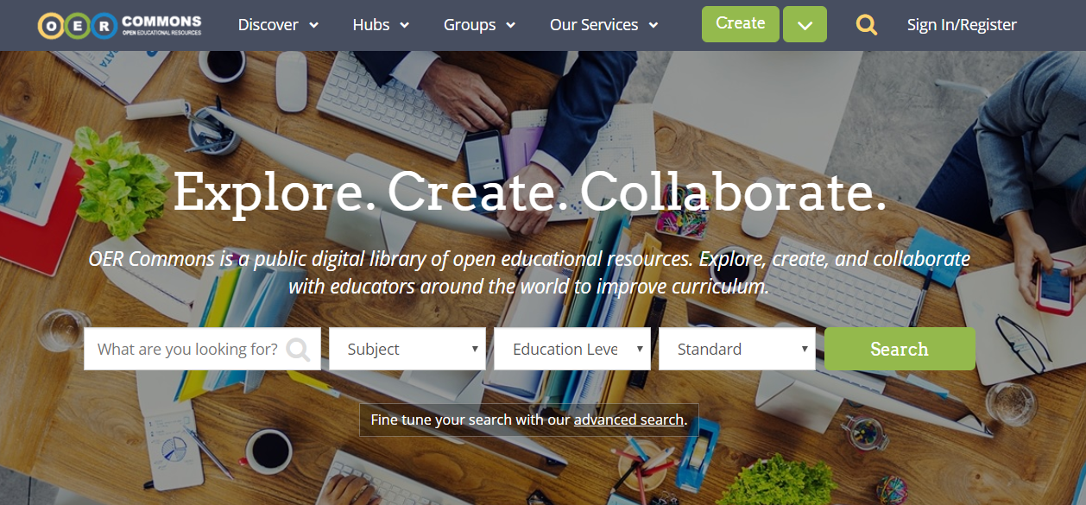
oercommons.org

Slide 42
textbooks.opensuny.org
Notes:
OPEN SUNY

Slide 44
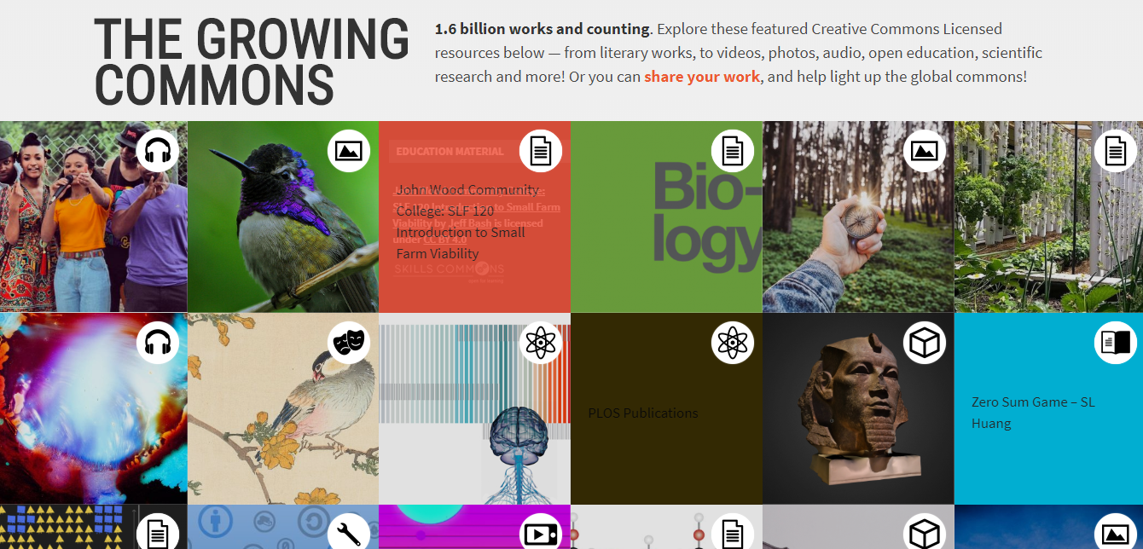
creativecommons.org
Notes:
creativecommons.org

Slide 45
The Open Community
ListServs
Librarians
Colleagues
VALE Resources
Open Textbook Network
OER Listserv

Slide 46
How?
Notes:
So how do you get the ball rolling at your institution? I’d like to present some strategies and advice about things that have worked for us and others.

Slide 47
Notes:
So right about now, you’re probably like this child…I think I know what I’m doing but what to do with all this information?

Slide 48
Notes:
Here are some of the main concepts I’m going to talk about with respect to implementing an OER initiative. Please keep in mind that this is going to be a very general overview and that we can go into any one of these in-depth this afternoon during the breakouts.

Slide 49
Planning
Funding & rewards
Leaders & diplomats
Models & scaling
Notes:
Planning is important; here are a few things to consider before you even start.

Slide 50
Notes:
What does this mean?

Slide 51
Notes:
This should make it even clearer: Money talks. Something else walks but I’d to keep this presentation rated PG. It’s one of the elephants in the room, so no use pretending it doesn’t exist. Let’s address this first.

Slide 52
Funding & Rewards
Potential funding sources:
Grant
Institutional
Potential funding structures:
One size fits all
Tiered:
Full / partial
Adopting / Adapting / Creating
Alternatives to funding (Rewards):
Release time
Tenure/promotion
Notes:
If you are fortunate enough, here are some ways to manage your funding. If you’re not as fortunate, there are other rewards to consider.

Slide 53
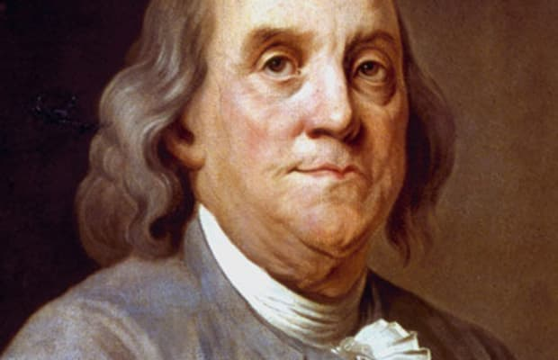
Notes:
Speaking of Benjamins…Why do I include a picture of Ben Franklin here?

Slide 54
Leaders & Diplomats
Organize
Inspire
Persuade
Communicate
Facilitate
Notes:
Good ol’ Ben was a leader, but he was also a diplomat…You are going to need people who are leaders and people who are diplomats, or if it’s just you at your institution carrying the OER torch, you’re going to have to be a leader and a diplomat. This may sound like Captain Obvious kind of stuff, but it’s important to keep in mind that ideas don’t get things done, institutions or processes don’t get things done, people get things done.

Slide 55
Notes:
Why do I include a picture of Ben and John Adams from the HBO miniseries? You can’t go in guns blazing and demand that people do what you want, right? Don’t be like John Adams when they travel to France, be like Ben. You have to wine and dine the folks you want to persuade. In our context, that means understanding the people you’re working with.

Slide 56
Faculty Mindset
Administration Mindset
Notes:
I’m admittedly speaking from a librarian’s perspective…it’s important to try and understand a faculty and/or administrator perspective. At OTN we did a whole exercise where we basically created a fictional faculty character, in order to understand different situations they may be in…

Slide 57
Facilitating Buy-in
Understand faculty and administrator mindset
Identify faculty champions
Present OER as an option (not the only option)
Let faculty lead
Understand your institution’s culture
Notes:
Here are a few more things you can do to facilitate buy-in…

Slide 58
Models & Scaling
Potential OER adoption models:
Courses with most expensive textbooks
Courses with highest enrollments
Courses within a specific department
All sections of one course
Whoever is interested
Notes:
If you’re starting from scratch, here are some of the most common adoption models. In other words, what courses do you want to target…You may be in a situation where all you have is the last option, and that’s OK. Anything is a start.

Slide 59
Notes:
So you have your funding in place (hopefully), your leaders and diplomats are ready to work their magic, you have a plan and a model you want to follow, so it’s go time. Teamwork makes the dream work. Note how there are 3 stick figures there. That’s called foreshadowing. As an aside, I’m fully aware of the irony that I haven’t given proper attribution for these photos, so I apologize in advance.

Slide 60
Teamwork
Groups of 2-3 are ideal
Determine working style
Workshops foster community
Deadlines get results
Notes:
A few tips for getting the actual work of developing courses done…

Slide 61
Review
Consistency and fairness
Verify sources are open/free
Official repository(ies)?
Standardize syllabus language
Ongoing process
Sample review checklist: https://pccc.libguides.com/c.php?g=954729&p=6888777
Notes:
So you’re getting close to the finish line, it’s important to have a review process in place in order to ensure some semblance of consistency and fairness. Here are some of the things we do…

Slide 62
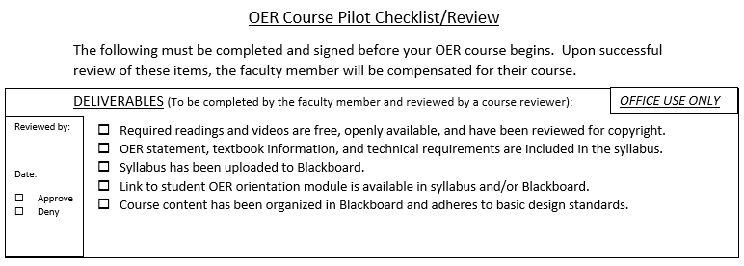
Notes:
Here are some screenshots of our current review checklist for OER courses. There are certain things we need to make sure the faculty have delivered, and other things that they authorize or acknowledge. We can talk about this more later if you’d like.

Slide 63
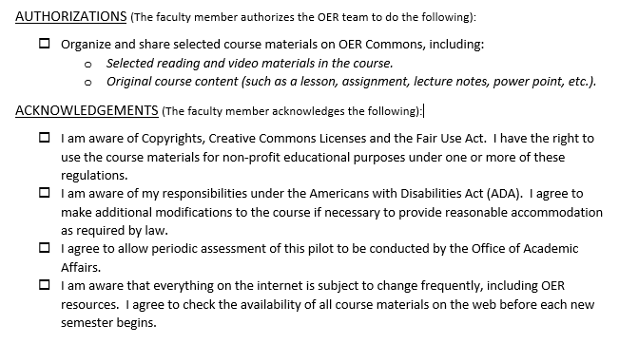

Slide 64
Advertisement
Registrar
Bookstore
Printing/copies
Orientation & support
https://pccc.libguides.com/oer/oer-students
Notes:
One of the final steps, but often overlooked or buried in administrative red tape. Make sure your students know that they’re signing up for an OER course. Have conversations with the Registrar and Bookstore. Provide orientation and support for your students.

Slide 65
Sustainability
Review sources regularly
Conduct assessment
Report successes
Scale course offerings
Keep the momentum going!
Notes:
Finally, when you’re done you’re never really done. Here are some things you need to do to keep the ball rolling. Try and assess how students are performing academically in OER courses, which is just as important an argument for OER as is the cost savings, perhaps more.

Slide 66
Notes:
Finally, for any success, no matter how small, shout it from the rooftops. Spread the good word.

Slide 67
2019-2020 OER Ambassadors
Thank you!
Alison Cole, Felician University
Ken Karol, Passaic County Community College
Janet Marler, Ocean County College
Marilyn N. Ochoa, Middlesex County College
The ambassadors can be contacted at njoerambassadors@gmail.com

Slide 68
Agenda
9:30 am – 10:00 am: Coffee & Registration
10:00 am: Welcome & Initiative Overview
10:20 am: Ambassadors on the Why, What, Where, & How of OER
11:30 am: Open & Affordable Textbooks Program at Rutgers
11:45 am: Interactive Activity
12:00 pm – 01:00 pm: Lunch
01:00 pm – 2:00 pm: Panel Discussion / Q&A

Slide 70
NJOERAmbassadors@gmail.com

